Slide 1
Classifying buildings post Hurricane
Team Members:
Alok Kumar Pandey
Tejas Chaturbhuj
Chetan Jagadeesh
Sahil Joshi

Slide 2
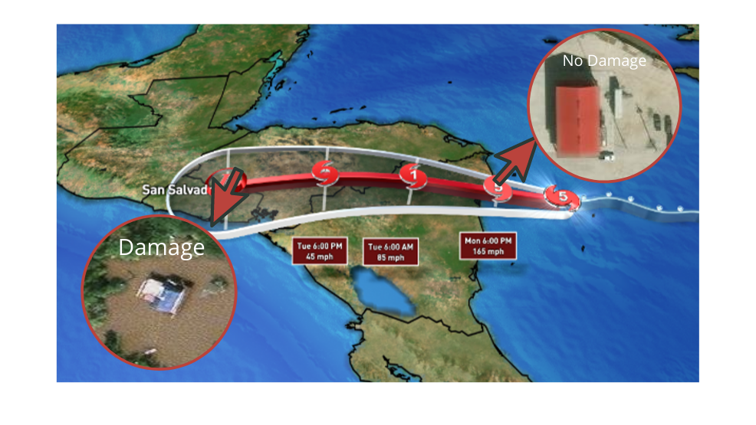
Introduction
It is essential to plan and allocate resources to the affected areas of the Hurricane. To find out which areas need immediate attention is a time consuming process.
To help alleviate this we are trying to build a model which will take into consideration the satellite images of the area and classify them as ‘Damaged’ or ‘Not Damaged’ using which we can decide where to allocate resources and helpers.
To address this problem we explored two approaches. In the first approach we made our own Convolutional Neural Network model using and in the other we are using the state of the art VGG16 model tuned specifically for our problem.
Source :https://abcnews.go.com/US/catastrophic-hurricane-iota-caribbean-category-storm/story?id=74230322

Slide 3
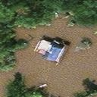
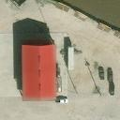
Exploratory data analysis
Damaged building
Undamaged building
For this problem we are using satellite imagery dataset splitted into training, validation and testing. We have a balanced training and validation dataset which will be used to train and fine tune our model. Once the model reaches desired performance we will be evaluating it on the balanced as well as the unbalanced test data which will paint a better picture of our model’s performance in real world.

Slide 4
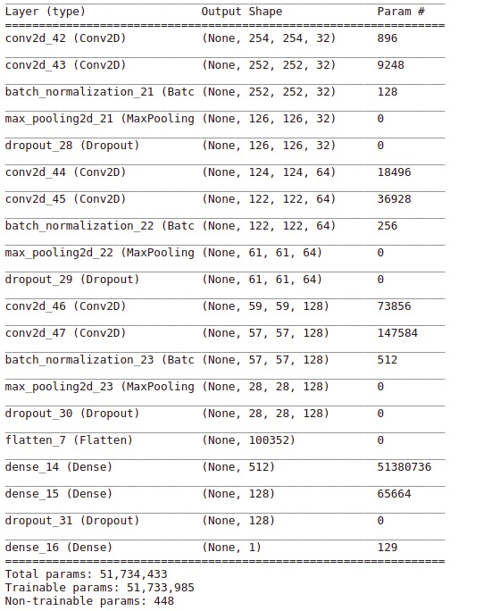
Custom CNN Model
For the custom model we are using a combination of 2 Conv2D layers, a Batch Norm layer, a Max Pooling layer and Dropout in the end.
We repeat the above layer architecture 3 times and then Flatten the network into two Fully Connected layers before adding the final output layer.
After preprocessing our data set, we trained this architecture for 20 epochs and got an accuracy score of 0.95 on test data.

Slide 5
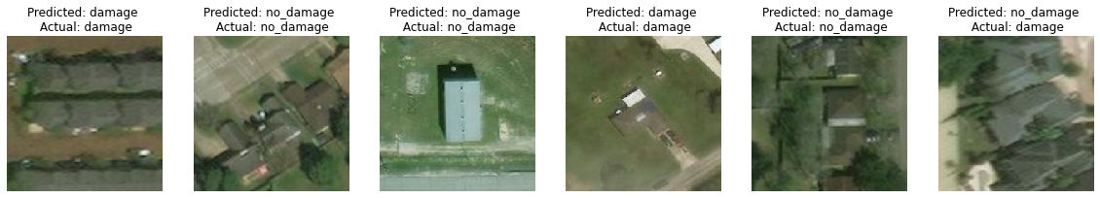
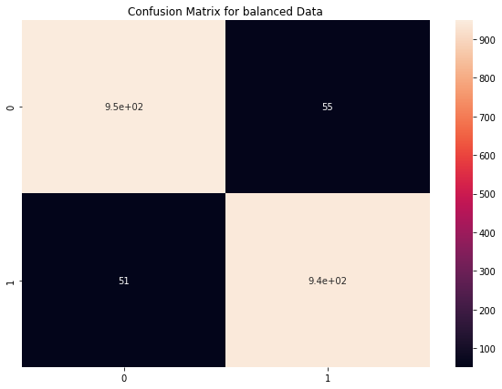
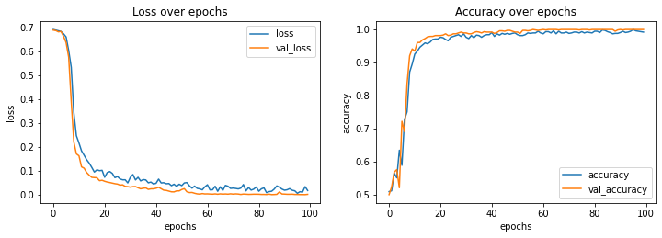
Results for CNN Model

Slide 6
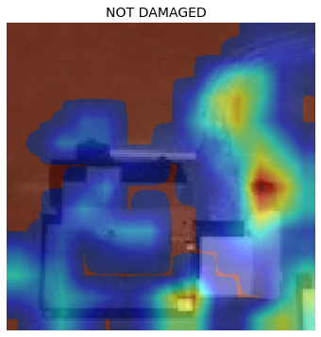
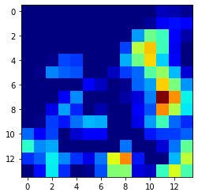
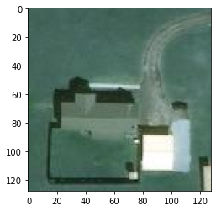
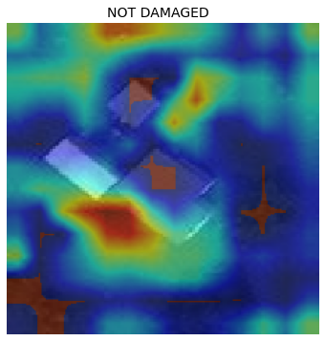
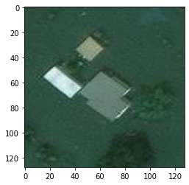
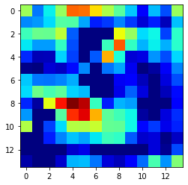
Saliency map
Not Damaged Buildings
Damaged Buildings

Slide 7
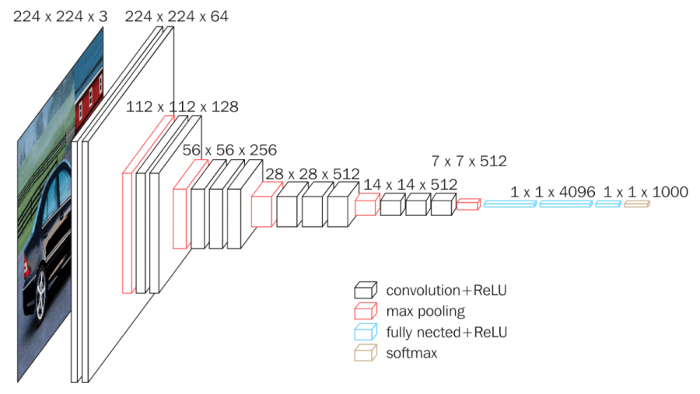
VGG16 Model
In this approach we are using a pre-built VGG16 model provided in the Keras library.
For this we load up the model and freeze all the layers.
We are using image augmentation on both training and testing data and then fit the model on the preprocessed training data.
With this model we were able to achieve close to 93% accuracy on the test data.
VGG16 Architecture
Source: https://neurohive.io/en/popular-networks/vgg16/

Slide 8
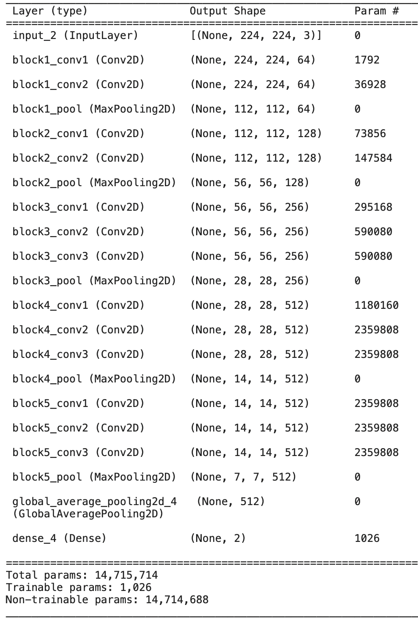
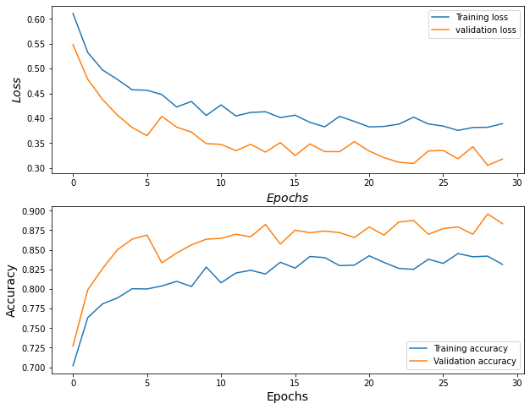
Results for VGG16 model

Slide 9
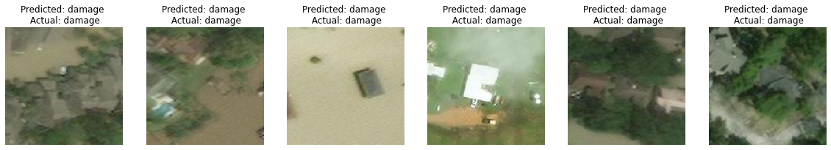
Results for VGG16 model
Prediction on Unbalanced Test Set
Prediction on Balanced Test Set

Slide 10
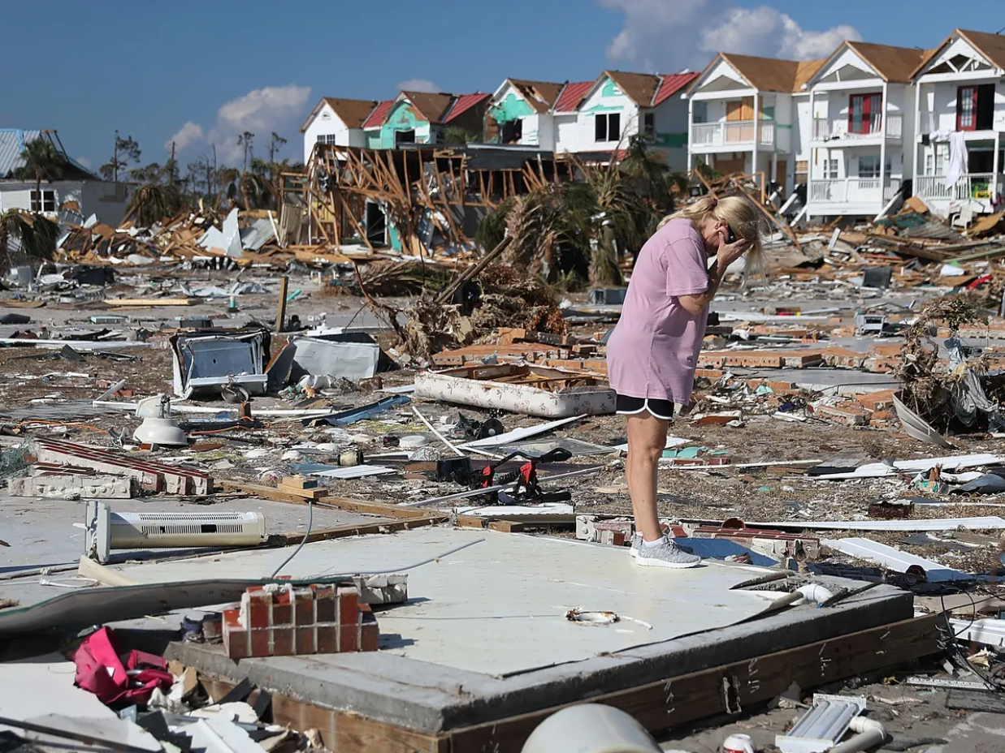
Conclusion
In our approach we can see our custom cnn architecture is outperforming the VGG16 model in this use case.
This is probably due to the fact that we have freezed all the layers in VGG16 model and therefore it is not able to train itself to our problem and more accurately classify the data.
In Future, we can try to implement image segmentation or object detection algorithm, which can be used to detect specific part of satellite map where damages were occurred.
We can also explore ResNets and some other more advanced models to see how it results.
Source: https://www.theguardian.com/world/2018/oct/15/us-year-of-hurricanes-extreme-michael-irma-florence

Slide 11
Thank you

